Slide 1
Effects of cross contamination in colour PTV
Keywords: Colour PIV, Iterative pressure reconstruction

Slide 2
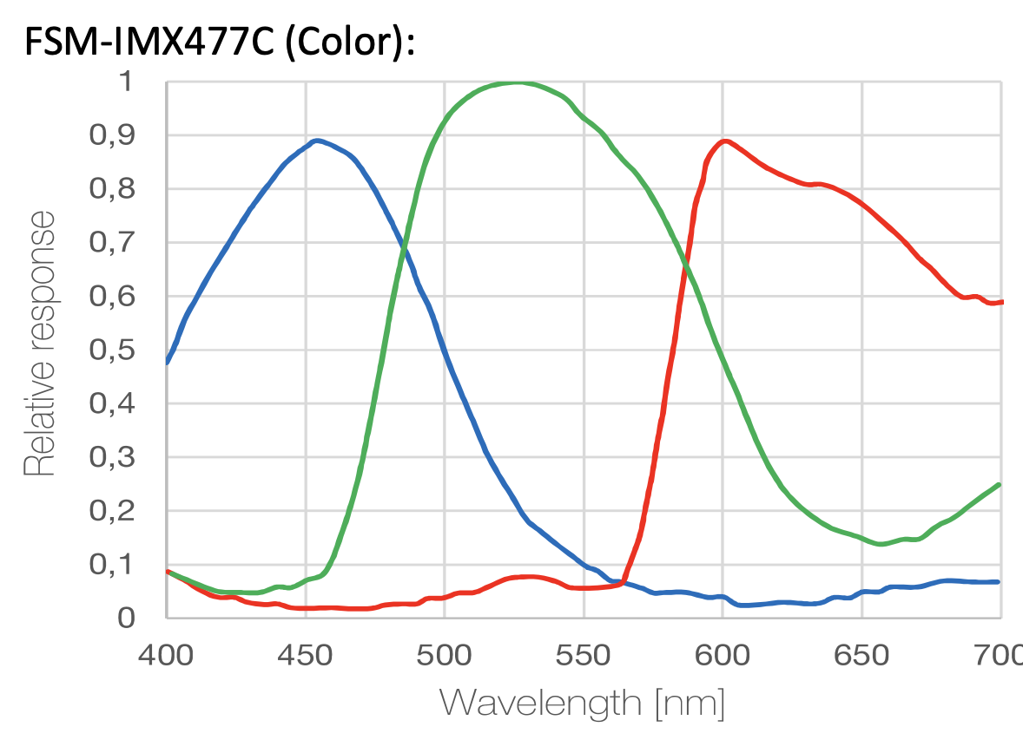
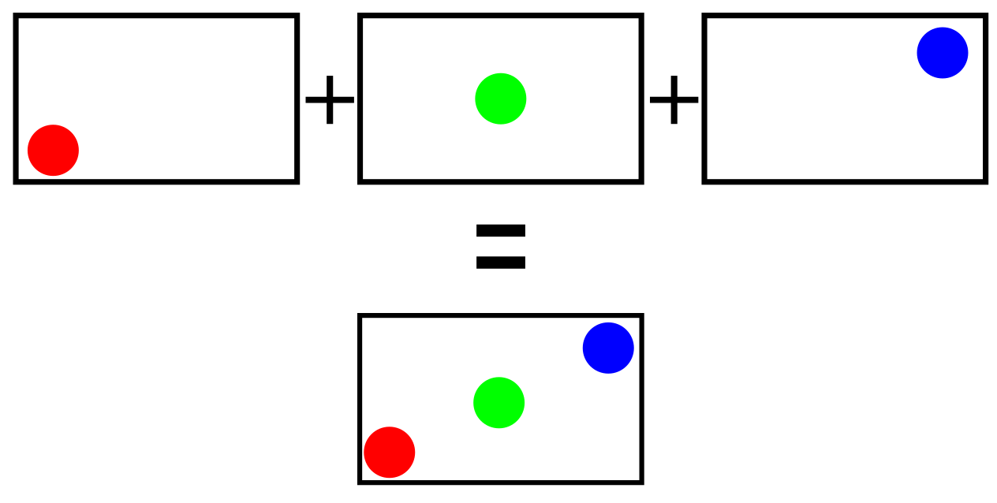
Project proposal
Track tracer particles in a fluid flow using red, green and blue lighting to reconstruct their path over short timescales
Because red LEDs don’t only activate the red channel, this colour spillage will need to be corrected in software
Particle tracking code will be written to evaluate the usefulness of the previous steps
Response to different wavelengths for a typical image sensor, Framos 2019
Visual aid for what synthetic images will look like, own work

Slide 3
Background
3D Lagrangian Particle Tracking in Fluid Mechanics (Schröder & Schanz, 2022)
Overview of the history of particle tracking
A triple-exposure color PIV technique for pressure reconstruction (Wang et. Al., 2017)
Using 3 colours to gain more temporal information with cheaper equipment
Most methods have used high-end optical systems to acquire the data, although some work has been done to lower the barrier to entry. This will be a continuation of those efforts

Slide 4
Aims and Objectives
Find the effects of colour contamination in colour PTV
Add the effects of colour spill into existing Gigatrack codebase
Quantify how much this affects the accuracy of synthetic particles
Test the code on experimental data
Gather data of real flows with real hardware
Test the data using the processing pipeline

Slide 5
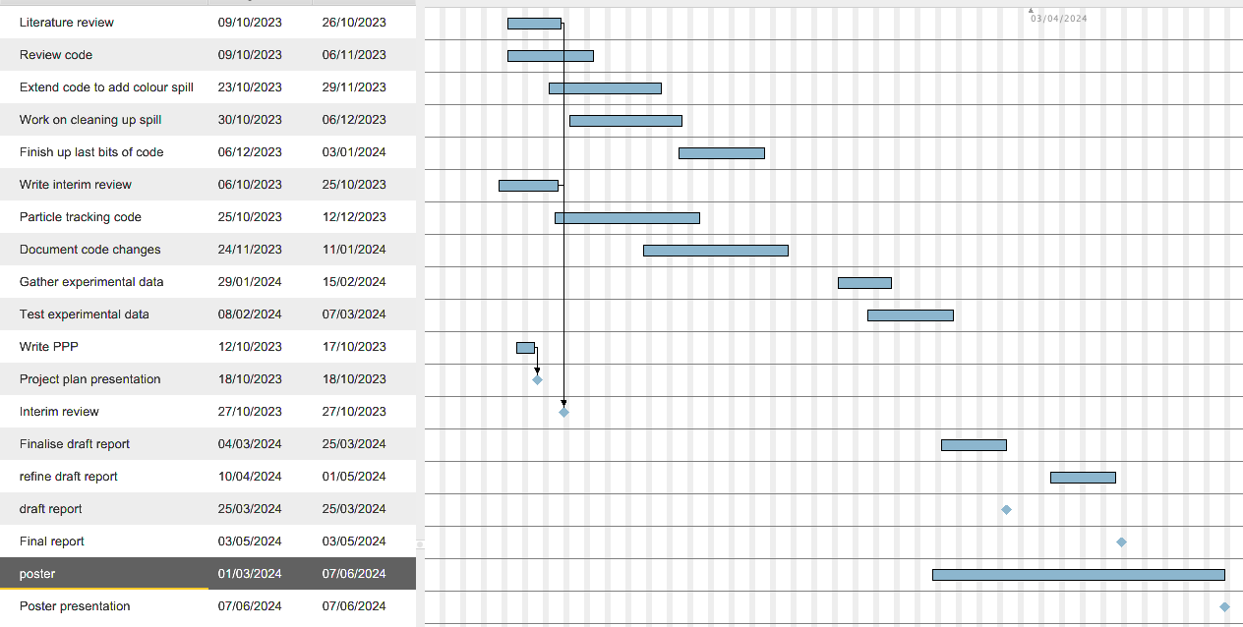
Rough timeline

Slide 6
Training needs
Lab induction – Later today
Codebase review – Tomorrow
General MATLAB experience - Ongoing

