Slide 1
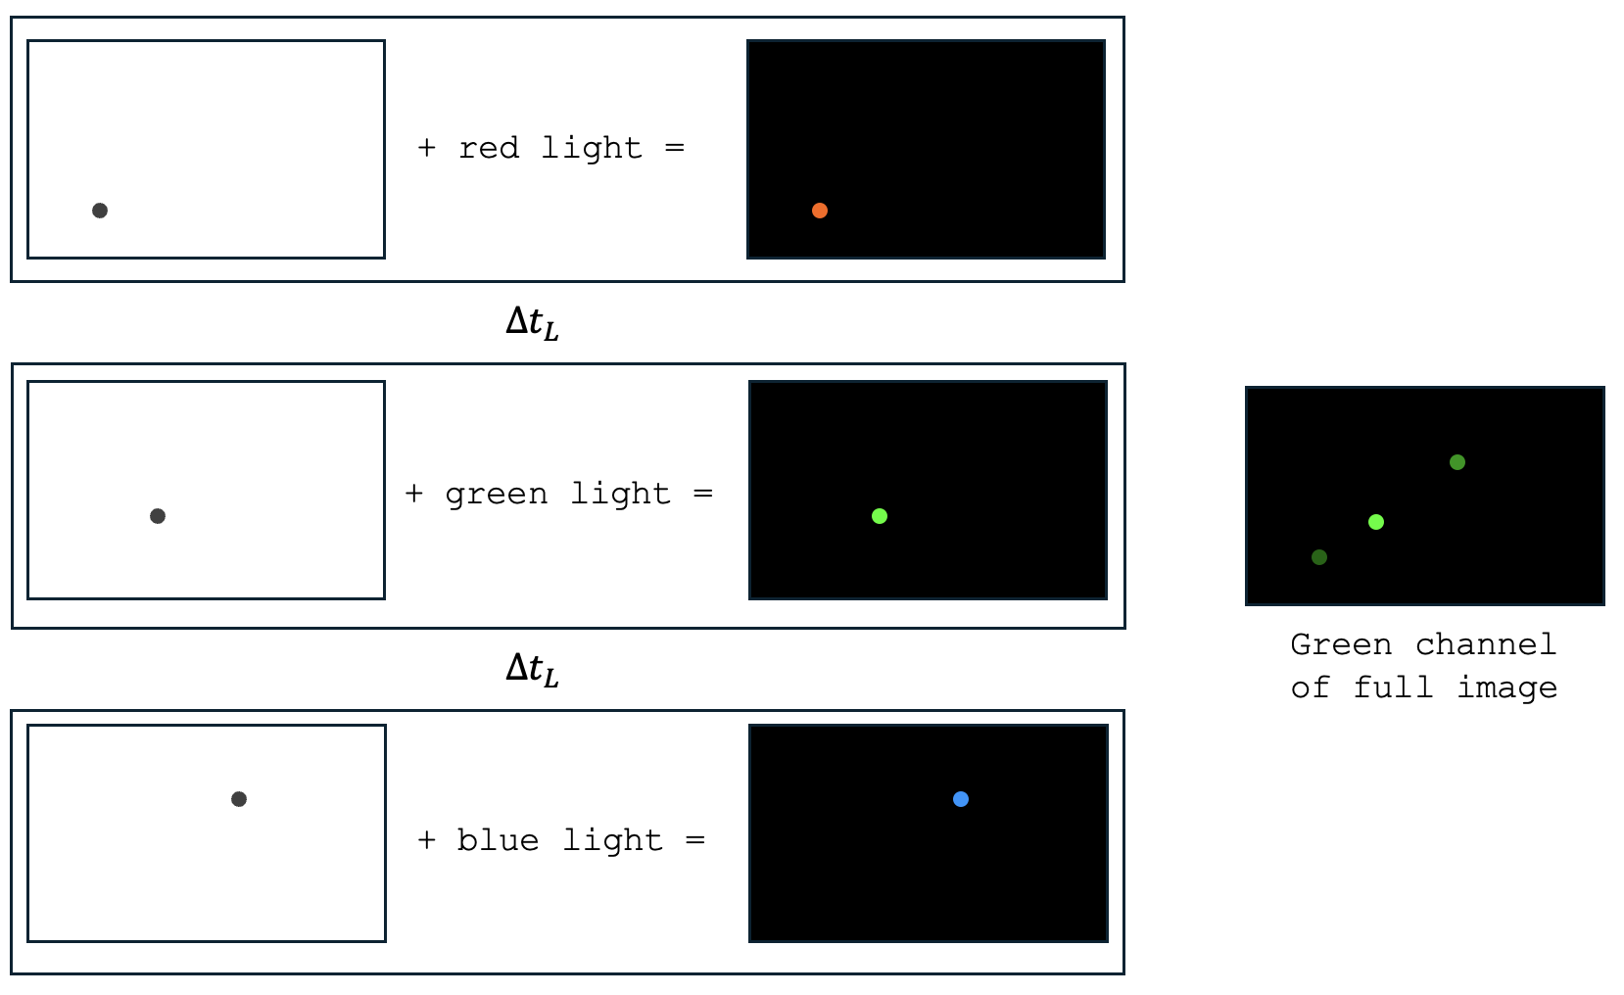
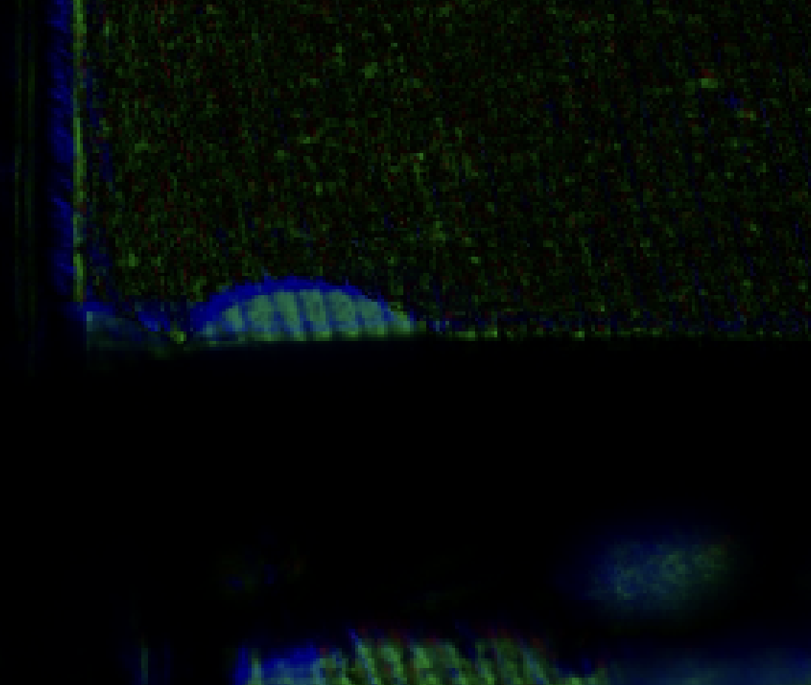
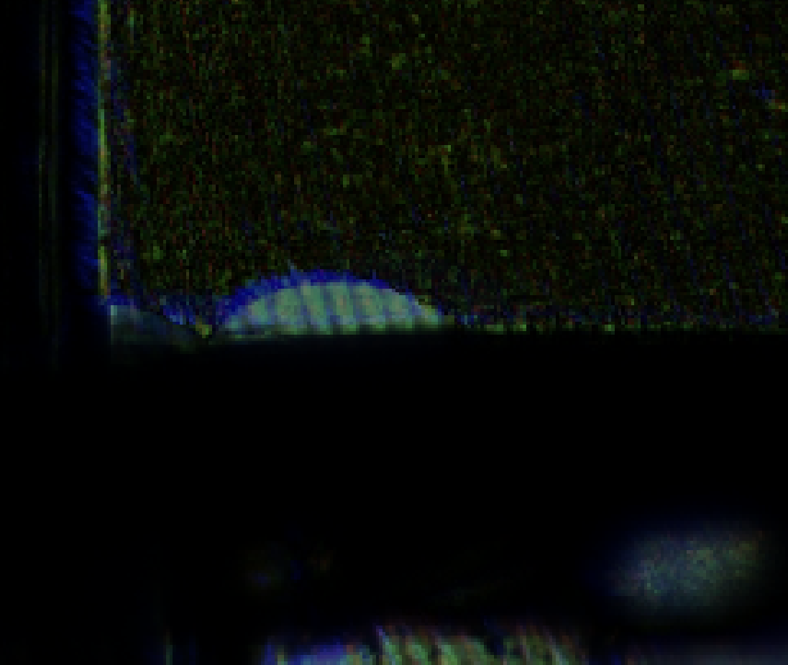
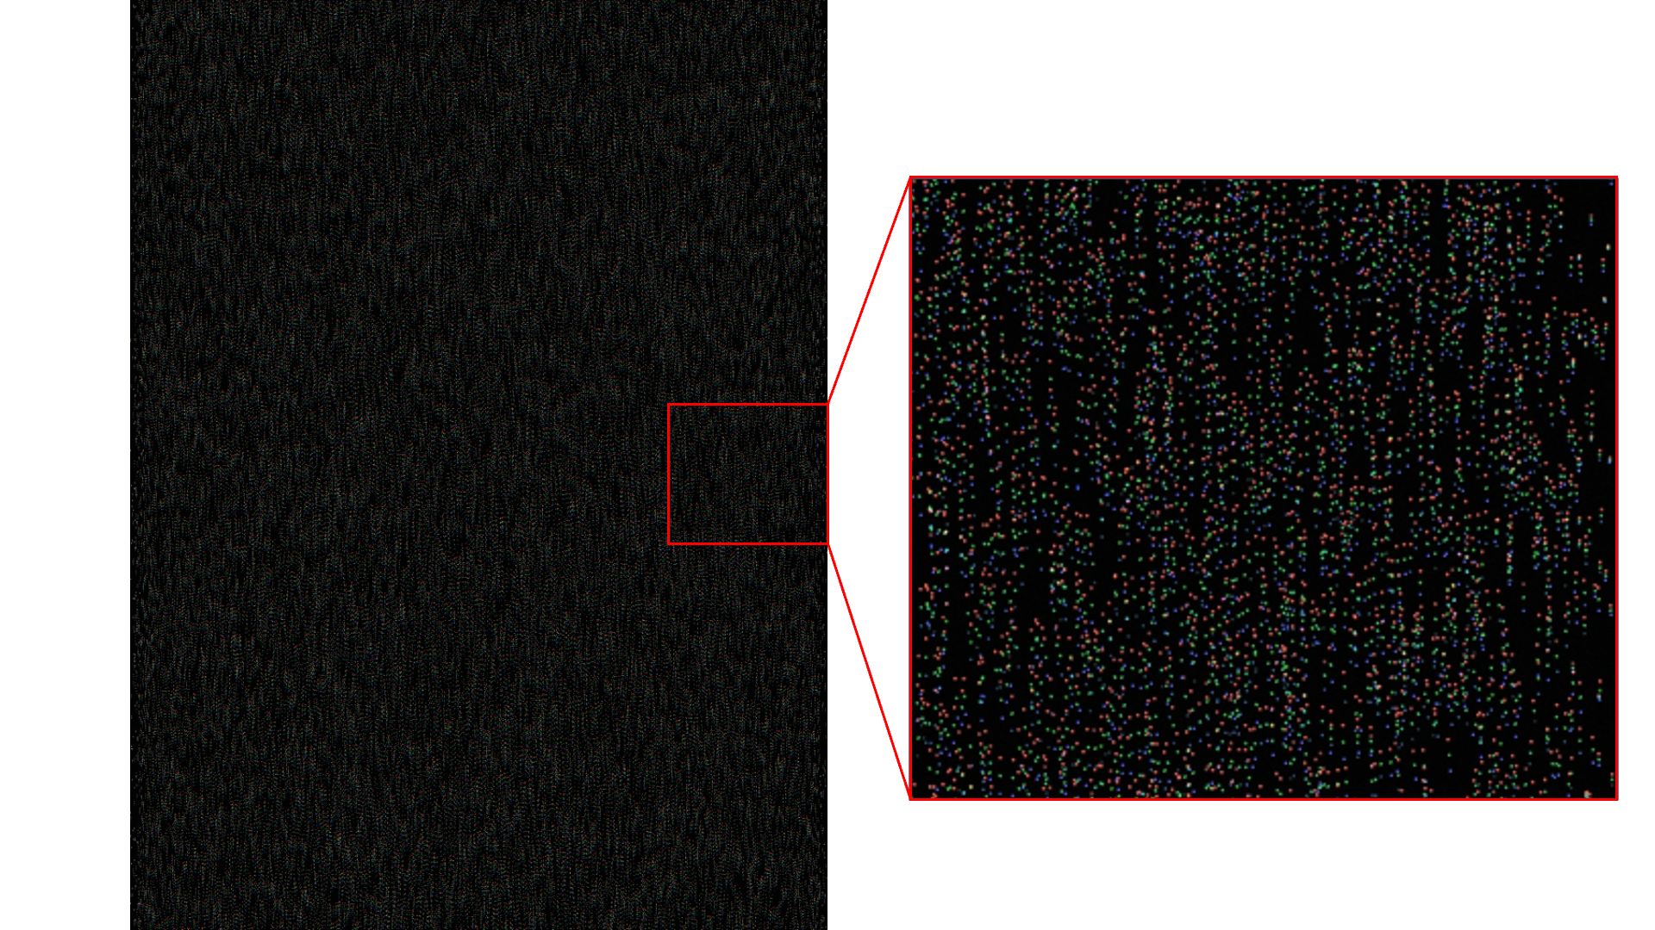
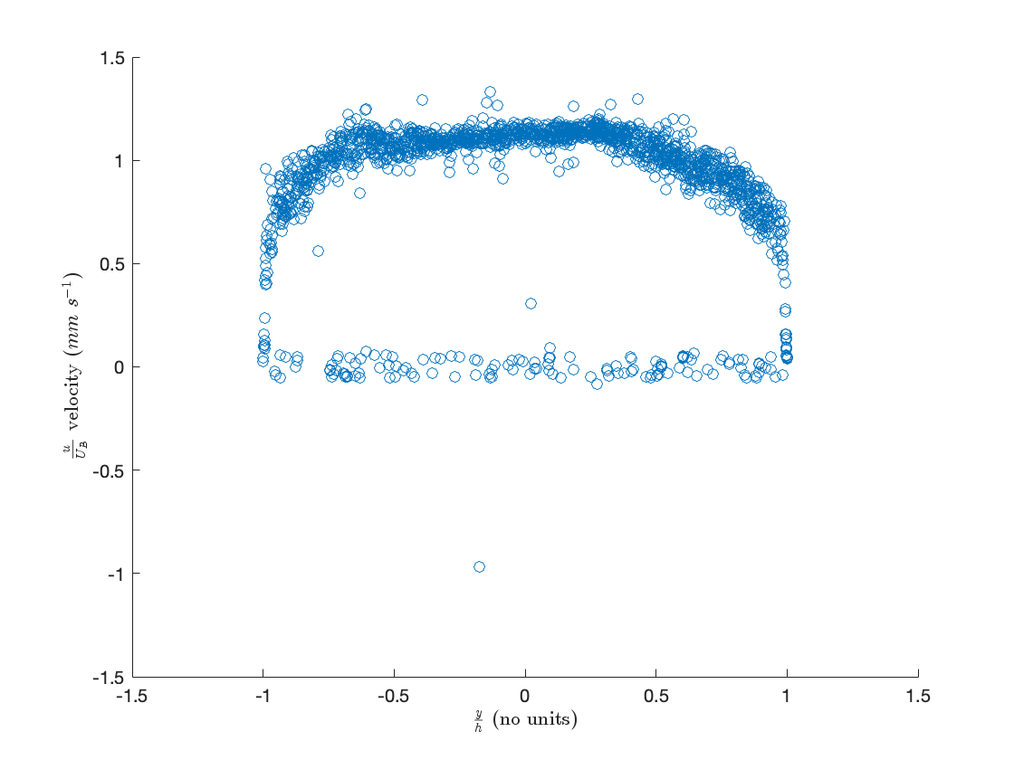
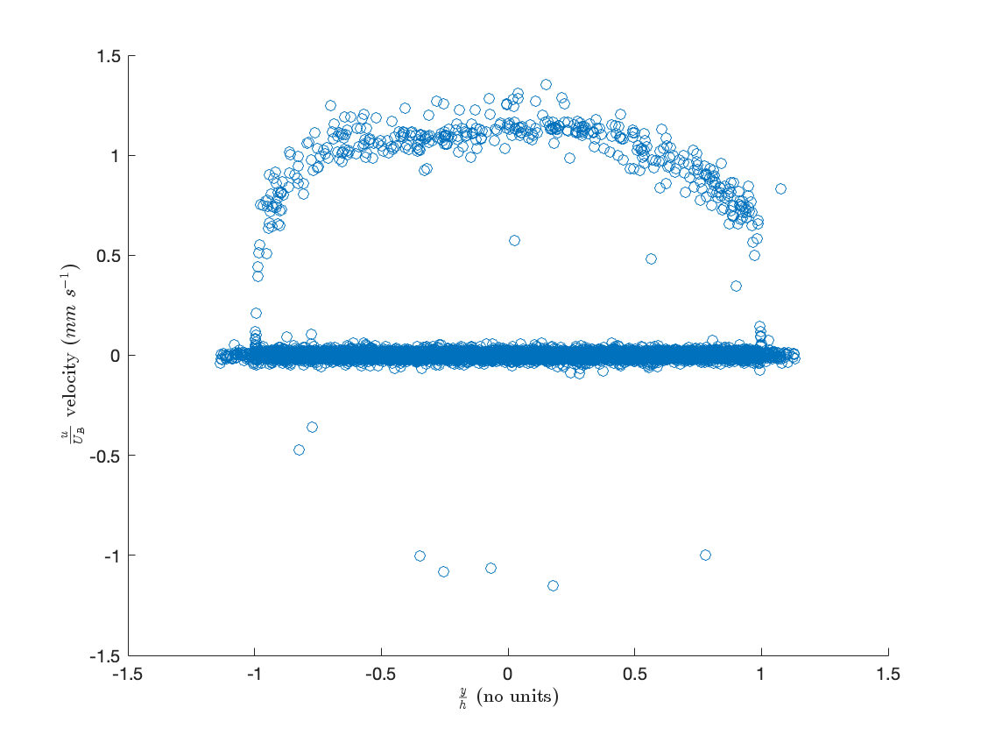
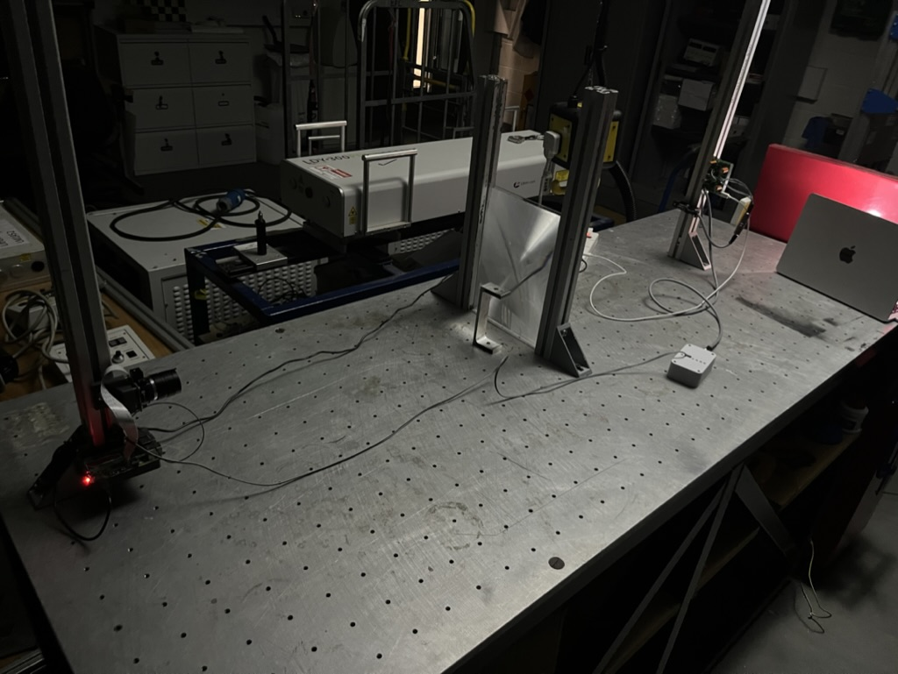
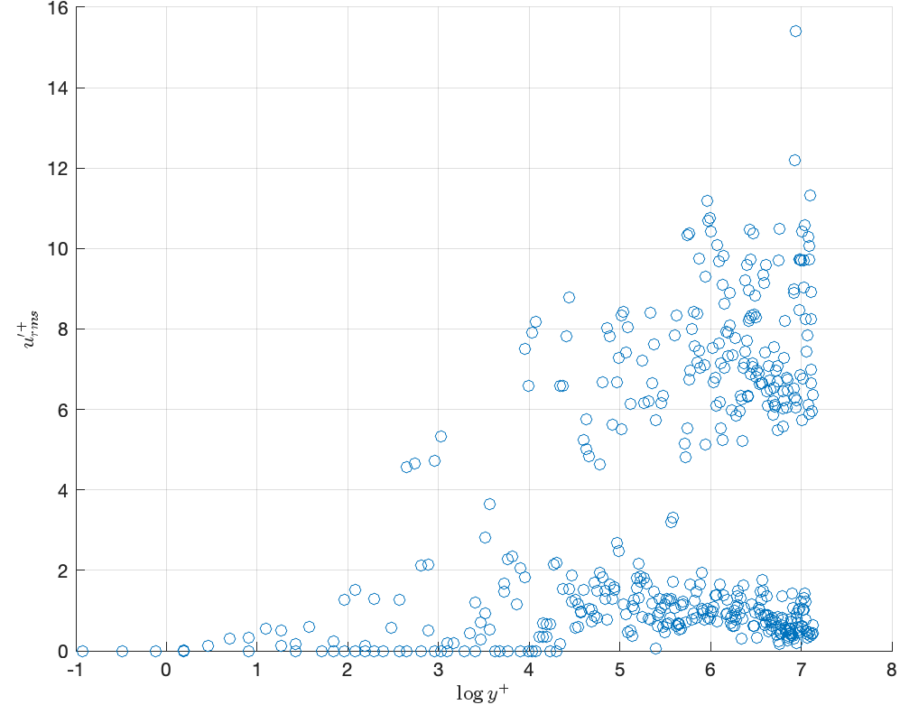
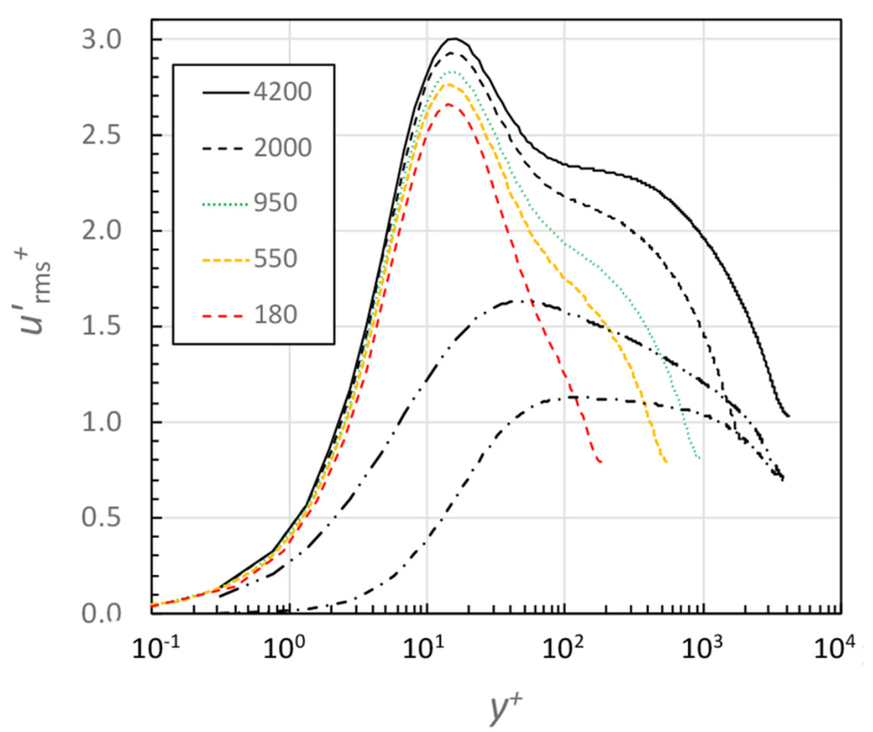
103
AM
What are the effects of linear mixing and how can they be mitigated for Triple-Exposure PTV
Natalie Ko-Ferrigno (32748361) – supervised by John Lawson
Particle Tracking Velocimetry (PTV) |  | Linear Unmixing
Finding a flow field in a region of interest through placing small (~10um) tracer particles in a fluid and imaging it. Computational methods can track particles through their motion |  | A technique to remove artefacts in from the Bayer matrix. Some work has been done on this for PTV and closely related fields, but it is primarily developed through microscopy and remote sensing.
Bayer matrix |  | Gigatrack
A pattern of colour filters over monochrome sensors to allow camera sensors to reconstruct colour data |  | MATLAB scripts to allow for low-cost PTV, developed by John Lawson
The problem:
PTV hardware is typically very expensive, so why not just use cheaper hardware?
This also allows for more temporal information on each image through multiple colour channels recording at different times
Consumer hardware leads to bad-quality data – can processing make it acceptable quality?
Imperfect colour filters lead to a large number of particles with zero velocity
The solution:
Get an undergrad to look at it
Minimise number of false particles while maximising number of real particles, so existing techniques can be used
Previous solutions include:
Find the correlation coefficient of the channels of light, if it is sufficiently low, reject
Find how much each light affects each type of sensor on the camera
Use cameras that reject these errors
More information on how it works:
Wang [1] shows the full method used
Charonko [2] mentions it in passing
Representative sample data gives the correlation between one channel and another
These 9 values are put in a matrix.
Test data is then captured, with each pixel being a vector of colour data
The colour data is multiplied by the inverse of the matrix to clean the test data.
Other applications of the technique
Flourescent markers in microscopy [3] (more relevant)
Determining ground composition in remote sensing [4] (less relevant)
Computational section
This section focused on extending Gigatrack to allow for simulation of the linear mixing.
With this developed, methods for linear unmixing could be tested to validate them.
There was already a matrix to show how the camera will respond to light, which was modified to represent linear mixing.
Linear unmixing was implemented through a preprocessing step, which saves the files in a distinct directory.
This allows for easy comparison between data with and without treatment.
Many different plots of the flow were made, and using this information, conclusions about the efficacy of the correction algorithm could be made
Experimental section
Key aims were to validate that the techniques developed could be extended to real data
Low-cost solutions added the issue of an inhomogenous background, which was overcome
The methods used were not as simple as in the computational section due to practical issues with measurement volume and time pressures.
Tooling was developed to allow images to be used in MATLAB
Shadows of particles were captured, so they needed to be inverted to be as Gigatrack expects.
Results
There are additional real-world effects that need to be accounted for (chromatic aberration primarily)
Software is easier than hardware
The system works
Results from this section
Linear mixing was a big enough problem, such that ignoring it would lead to unusable data.
While imperfect, the method presented was adequate to get a good degree of accuracy from imperfect image.
The corrections were not able to fully remove all erroneous data, but it was incredibly effective in correcting most of it.
Future work
Improve speed of processing to allow for processing of large datasets
Further iteration on background removal
Investigate ways to improve accuracy of synthetic data
More experimental testing and validation
Integration with a real system
References
[1] - Wang, Z., Gao, Q. & Wang, J. A triple-exposure color PIV technique for pressure reconstruction. Sci. China Technol. Sci. 60, 1–15 (2017). https://doi.org/10.1007/s11431-016-0270-x
[2] - Charonko, J.J., Antoine, E. & Vlachos, P.P. Multispectral processing for color particle image velocimetry. Microfluid Nanofluid 17, 729–743 (2014). https://doi.org/10.1007/s10404-014-1355-5
[3] - Zimmermann, T. Spectral Imaging and Linear Unmixing in Light Microscopy. In: Rietdorf, J. (eds) Microscopy Techniques. Advances in Biochemical Engineering, vol 95. Springer, Berlin, Heidelberg. https://doi.org/10.1007/b102216
[4] - Ceamanos, X. & Valero, S., “Processing Hyperspectral Images” in Optical Remote Sensing of Land Surface, https://doi.org/10.1016/B978-1-78548-102-4.50004-1
Notes:
Size: A1: 594 x 841 mm, Portrait
Normal font size: 18 pt
Minimum font size: 12 pt
Titles font size: 40pt+
Put your name and ID and supervisor name on
Either put your poster number and AM or PM in the corner or leave blank so that we can write with a pen.

